Slide 1
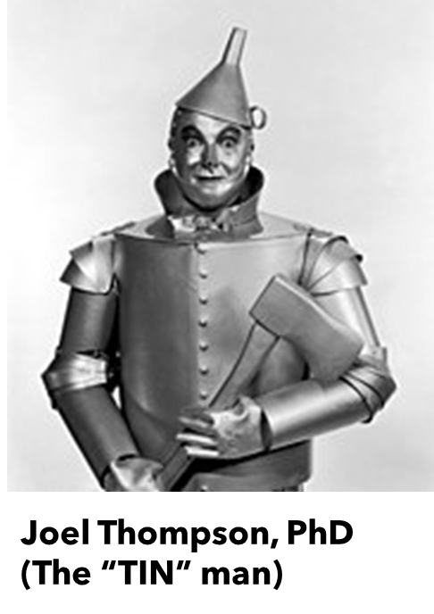
Trial Innovation Network (TIN)
Greg Jicha, MD-PhD
Ashley Hall, MS
Joel Thompson, PhD

Slide 2

The TIN embeds a top-down & a grass-roots approach to clinical research…
Have an idea, you don’t know how to move forward?
NCATS is looking for:
new projects with new compounds
repurposing of existing drugs
They can help investigators navigate the complex processes that will make a grant/trial turn into a success
Move
your idea
forward…
Get help from the National CCTS network & NCATS to make it happen
Enable a network of sites to engage and support your research through clinical trial engagement or just be a site
What if clinicians just want to be an investigator for now & build experience?
There is a need for clinical trials teams to engage in NCATS trials
The TIN can help you If you are an investigator that wants to get involved but don’t know how to find trials to engage in!

Slide 3
Moving ideas forward…
Linda Van Eldik’s project is a prime example of TIN engagement:
Multiple grants have been successively funded to support this initiative including: RF1AG064859, U01AG050636, R01AG061898, R01AG069930, U01AG076480
The ongoing BEACH trial and the prior Phase 1 studies are UK products of the TIN.
UK TIN has supported this study through its conception and is well underway at UK, with the support of CCTS services.
The trial is ongoing but has been extremely successful with UK CCTS support and we expect a successful trial shortly.
This agent, MW189, is planned to enter early stage dementia trials imminently through additional NIH funding that has successfully achieved funding R01AG061898, R01AG069930, U01AG076480.

Slide 4
Other accomplishments…
Emerging from the COVID pandemic, the UK CCTS was successful in serving as the highest recruiting Janssen trial site in the world.
UK work on vaccination clinical trials remains one of the most robust on the field.
The UK CCTS in conjunction with the TIN leader (Jicha) moved one of many anti-Alzheimer agents forward through phase 2 and 3 studies. This agent, lecanemab/Leqembi® is the first agent to achieve full FDA approval and be offered in standard clinical practice here at UK and beyond.
The CCTS is engaged in the AHEAD study, representing the largest NIH commitment to preventing Alzheimer’s disease through two innovative clinical trials conducted at UK
UK is the 2nd leading academic site in the world for screens and is in the top 5 for enrolled participants.
UK efforts in drug addiction combating the opiate crisis and efforts in cancer treatments are key traditional strengths for the UK CCTS that remain strong.
Intranasal Narcan has become a standard world-wide in endemic substance abuse areas. The UK CCTS and the TIN continues to work strongly in these areas in addition to those mentioned above that are making headline news regularly.

Slide 5
21 trials turned away by UK last year, while we could have contributed…
Study short title | Study full title
S-CitAS Study | Escitalopram for Agitation in Alzheimer's Disease
HEAL: SKOAP | A Sequenced Strategy for Improving Outcomes in People With Knee Osteoarthritis Pain
PCT-guided Antibiotic Use for Pediatric CAP | PCT-guided Antibiotic Use for Pediatric CAP
ACT NOW | Pragmatic, Randomized, Blinded Trial to Shorten Pharmacologic Treatment of Newborns with Neonatal Opioid Withdrawal Syndrome (ACT NOW)
ACTIV2: Adapt Out COVID | Accelerating COVID-19 Therapeutic Interventions and Vaccines
SHARP Trial | SpHincterotomy for Acute Recurrent Pancreatitis Trial
PepCan Trial | A Phase I/II Clinical Trial of PepCan in Head and Neck Cancer Patients in Remission to Reduce Recurrence Regardless of HPV Status, Head and Neck Cancer PepCan Trial.
ACTIV-1 | Accelerating COVID-19 Therapeutic Interventions and Vaccines
PENS | A Placebo-Controlled Effectiveness in INPH Shunting (PENS) Trial, A Placebo-Controlled Effectiveness in INPH Shunting
PRESTiGE | PReseasonal Soy -isoflavone Treatment by Genotype to prevent Exacerbations
KO/STEC Trial | Volume Expansion to Improve Kidney Outcomes in Children with Shiga Toxin-Producing E. coli Infection: A Multinational Cluster Randomized Crossover Trial
BEACH | A Randomized, Double-Blind, Placebo-Controlled, Phase 2a Proof-of-Concept Study of MW189 in Patients with Acute, Non-Traumatic, Intracerebral Hemorrhage
THE PE-TRACT TRIAL | PULMONARY EMBOLISM - THROMBUS REMOVAL WITH CATHETER-DIRECTED THROMBOLYSIS
HEAL: SurgeryPal | mHealth Psychosocial Intervention Postsurgical Pain
INSIDER | The International Subarachnoid Hemorrhage Comparative Effectiveness Research Alliance
New Ideas Study | Imaging Dementia-Evidence for Amyloid Scanning Study
Cardiac Arrest Survivorship: a Mixed Methods Study | CARDIAC ARREST AWARENESS AND LONG-TERM QUALITY OF LIFE: A MIXED METHODS STUDY OF THE EXPERIENCES AND PSYCHOLOGICAL CONSEQUENCES OF ADULT CARDIAC ARREST, Cardiac Arrest Survivorship: a Mixed Methods Study.
Provider-Focused Training Program in Autism | A Novel Provider-Focused Training Program to Serve Transition-Age Youth and Adults with Autism Spectrum Disorder, Provider-Focused Training Program in Autism
3,4 DAP for ALS | EE2 TRIAL OF 3,4 DIAMINOPYRIDINE (DAP) FOR ALS, 3,4 DAP for ALS
TIC-TOC | Traumatic Injury Clinical Trial Evaluating Tranexamic Acid in Children
DHCA Study | A Pilot Study Examining Conscious Awareness and Cognitive Experiences During Deep Hypothermic Circulatory Arrest

Slide 6
Contributing to TIN initiatives and building clinical trial engagement…
The UK CCTS has quickly provided the available information on the other trial opportunities afforded through the TICS and RICS network to faculty in key areas of engagement.
The CCTS engages not only the TIN, but also TriNETX and is developing EPIC Cosmos to help identify both trials and trial populations at UK
Unfortunately, there has been limited engagement as none of the potential investigators felt that they had the time commitment, populations, resources and/or interest to engage in successful conduct of these clinical trials at this time.
In response we have initiated targeted educational presentations to increase awareness of the TIN
Developed a questionnaire to engage the faculty and have incorporated responses into future planning.
Further developed initiatives based on consultation with Dr. Dixie Thompson from U Utah who is a key national TIN leader

Slide 7
Why aren’t we more successful?
What do all active researchers say?
What do clinicians say are the barriers?

Slide 8
What we are considering…
I have reflected on these accomplishments, the transition of Dr. Thompson to CSO of the CCTS, and the direction of the future CCTS TIN as follows:
We need to enhance & strengthen education and support for TIN services in conjunction with other CCTS and UK initiatives
We need to develop a boots on the ground approach (job position) to seek out clinicians and researchers for TIN engagement to support Joel that I hope will continue to provide oversight & consultative services to the TIN given his years of experience…
Such a job position will enhance communication with scientific teams to enhance the top-down approach by helping to identify “hidden” faculty members that may be needed to support developing projects as well as the researchers that may have ideas ready to move forward.
This position will also engage junior faculty by navigating the resources for success which include departmental DOE negotiations to make research attractive and facilitate departmental support for the activities to reduce pure wRVU driven productivity by these faculty that may struggle with such negotiations.

Slide 9

We welcome suggestions to help us move forward?

