Slide 1
Developing a Statewide Opioid Risk Prediction Program
Svetla Slavova, PhD
Professor, Biostatistics
Jeffery Talbert, PhD
Professor, Biomedical Informatics
Notes:
Hello, I'm Jeff Talbert and I'm here to discuss work I'm doing with Svetla Slavova on Developing a Statewide opioid risk prediction program

Slide 2

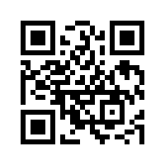
BACKGROUND
With funding from the National Institute on Drug Abuse (NIDA), we are developing the Rapid Actionable Data for Opioid Response in Kentucky (RADOR-KY) Data System.
MPI Svetla Slavova, PhD
MPI Jeffery Talbert, PhD
Primary award R01DA057605
3 Supplements:
AI Bias, Social Media data, KORE Application
Notes:
We call our project RADOR KY, which is RAPID ACTIONABLE DATA FOR OPIOID RESPOSE
This project is funded by a National Institute for Drug Aabuse R01 as the prime award, and we have 3 supplements:
One focused on AI Bias,
One on Social Media data with Russ Altman at Stanford,
and one developing a data tool for the KY Overdose Response Effort.

Slide 3
BUILDING ON LESSONS LEARNED FROM THE HEALING COMMUNITY STUDY (HCS)
HCS developed analytical capacity that could be leveraged after the end of the HCS.
Timely data is key for informed public health response.
Agencies and communities need comprehensive data on modifiable risk factors and evidence-based practices.
Partners pointed that it is not enough to look backward; predictions and forecasting could improve planning and resource allocation.
Notes:
Our work for RADOR builds off our participation in the KY HEALING COMMUNITIES STUDY.
To conduct the HCS study, we had to generate data at the county level on over 100 measures.
As we worked with local communities, we kept hearing that this is great you can show us all this data, but we need to know what is coming, not what has happened.
So Timely Data is key to allow for rapid response.
The data can then be used to support implementation of evidence-based interventions.
So our goal for RADOR was to develop a prediction and forecasting system to improve planning and resource allocation.
-

Slide 4
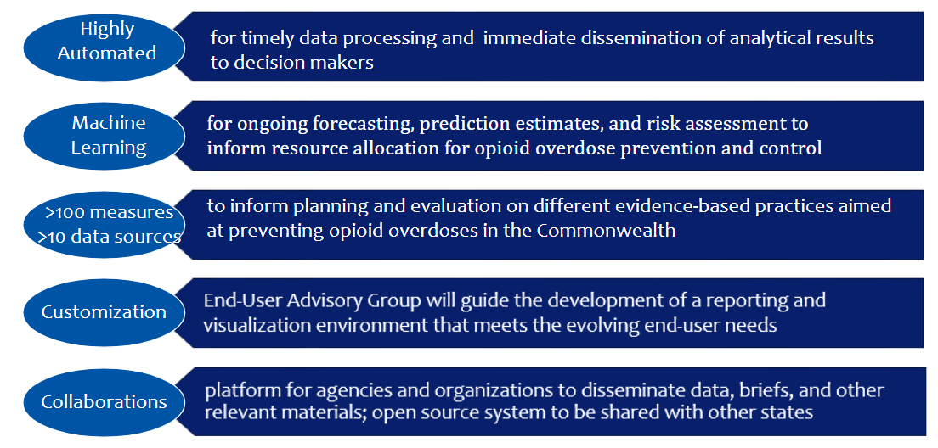
THE VISION FOR RADOR-KY
Notes:
The idea of RADOR is to take all the available data and predict future events
to provide ACTIONABLE DATA to STATE and LOCAL Officials.
To get the timely data to ACTIONABLE information.
WE make the data flows that are highly automated
WE USE MACHINE LEARNING for prediction estimates
WE use over 100 data measures for over 10 data sources
We work with an END USER Advisory Committee to help develop CUSTOM DASHBOARDS
And WE COLLABORATE with State agencies and organizations to disseminate data
We also developed the system with open-source tools so we can share the source code and system design with other users.
We are currently working with Arkansas and Ohio on possible dissemination grants.

Slide 5
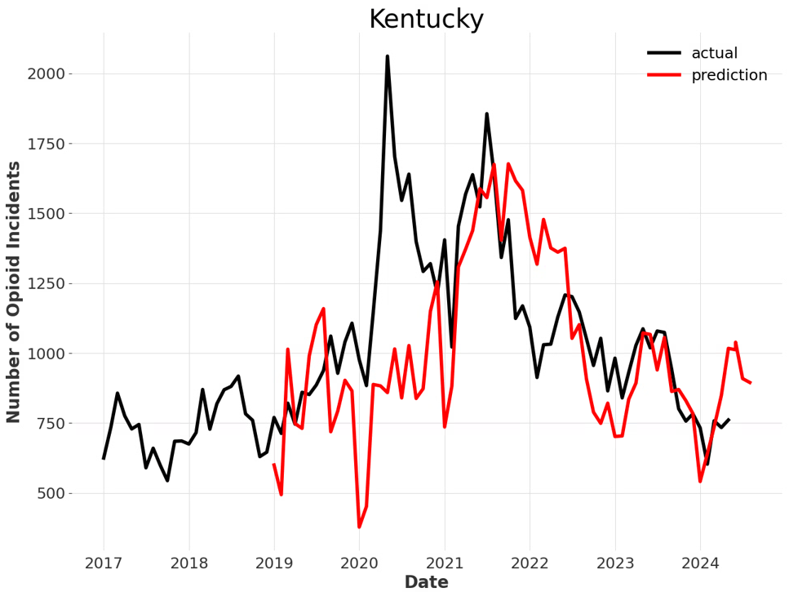
HISTORICAL PREDICTIONS OF EMS OPIOID OVERDOSE INCIDENTS
Can use expanding window to visualize predictions over time
Train model on first 24 months, predict for next 3 months
Then incorporate next 3 months into training and predict the following 3 months
Repeat continuously until entire time series has been used
Notes:
The outputs from RADOR are predictions, dashboards, and hot spot analyais.
Here is an example of predictions for EMS overdose events at the state level.
Here we show the timeline from 2017 to present.
We train the models on 24 months of data, then predict the next three months.
This chart shows all the predictions at once, but they were generated for three months, then rolling forward to predict the next three months using available data.
Overall the models perform well---the red and black lines follow a similar pattern----with the exception of COVID, where the model did not predict the large increase in 2020. It stabilized in 2021 and beyond.

Slide 6
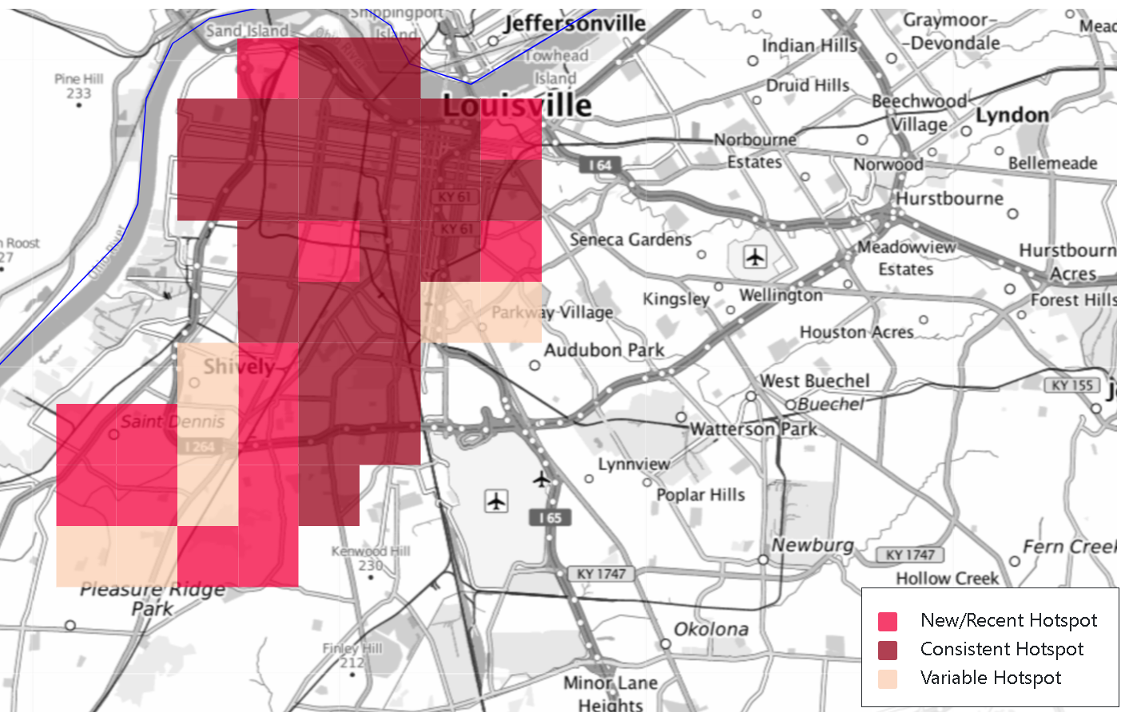
EMERGING HOT SPOTS
With input from our stakeholder engagement workgroup,
re-categorized EHA types into 3-level category:
New or Recent, Consistent, Variable
Emerging hot spot analyses reveal both spatial and temporal trends;
These trends are needed to understand changes in opioid overdose events and to provide rapid and actionable data to community stakeholders.
Jefferson County, Kentucky: (week 1 in January 2024)
Notes:
Here is an example of an emerging hot spot analysis that show spatial and temporal trends.
This shows Jefferson county, the Louisville area.
The boxes in dark red show a consistent hot spot,
Bright red is a new hotspot,
And light pink is a variable hotspot.
We can look at this view at the week level due to large size of the county, and we can zoom in to see city blocks.

Slide 7
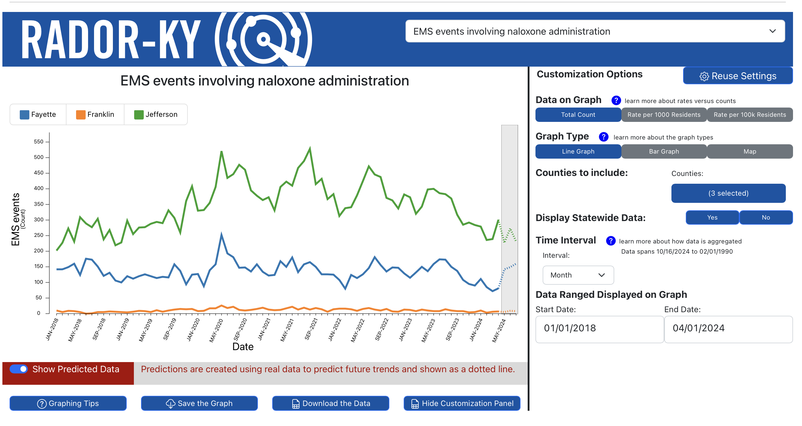
Notes:
Here is an example of a community dashboard
They allow custom selection of county, region, and all measures.
This one shows statewide and Fayette counties EMS events by month.
Note the period in grey—this is how the predictions look. The dots show predicted values.
The customization allows for selection of different areas, timelines, and chart types.

Slide 8
FUTURE DIRECTIONS
We are developing this infrastructure and tools for opioid use disorder, but it could be used for other areas.
What might our next priorities be for expanding use of this approach for new target conditions?
What national organizations beyond other CTSA hubs would be interested in expanding such work?

