Slide 1

Training Programs

Slide 2
T32 Pre-Doctoral and Post-Doctoral Training Program Plans
Pre-Doctoral Directors: William W. Stoops, PhD and Lauren N. Whitehurst, PhD
Post-Doctoral Directors: Brian Noehren, PT, PhD, FACSM and William W. Stoops, PhD
Administrative Director: Victoria L. King, PhD

Slide 3
K12 Training Program Plans
Thomas H. Kelly, PhD Matthew L. Bush, MD, PhD, MBA Vicky King, PhD

Slide 4
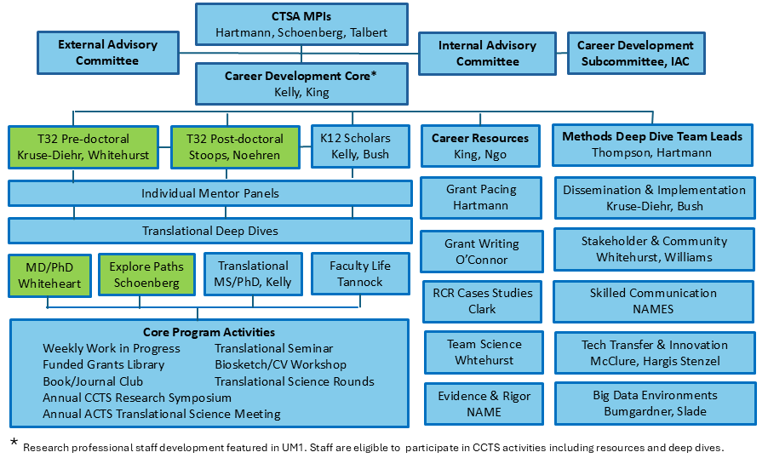
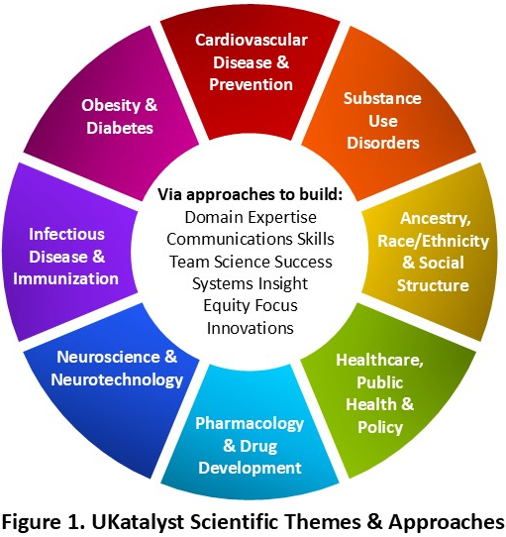
Integrated UKatalyst Training & Career Development Core (K12/T32s) and Themes

Slide 5
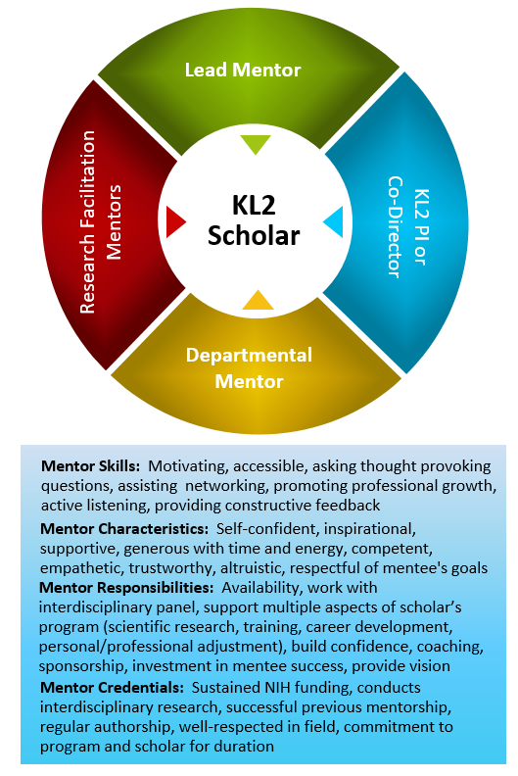
Common Curriculum
Vertical Integration
Mentored Research Training
Mentor Training (CIMER) – Strongly recommended in past – now required
Flight Tracker
Next Generation Mentors to compliment Lead Mentors
Figure 3. Structure & Roles of Interdisciplinary Mentor Panels
Modified from Bahgia 2000

Slide 6
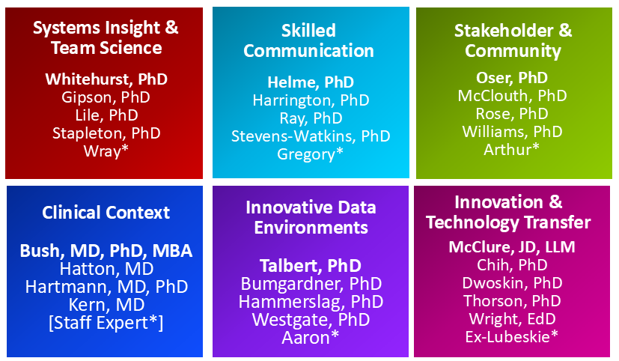
Common Curriculum
Work-in-Progress Meetings (Weekly Peer Mentoring)
Dissemination and Implementation Workshop
Individualized Clinical & Translational Scientist Competency Deep Dive
Biostatistics and Biomedical Informatics Clinics
Studios (1.5 hr consultation)*
Figure 4. Deep Dive Consulting Teams: top name is team lead; * indicates senior staff professionals working in research in the thematic areas.

Slide 7
T32 Objectives
Innovate research training and career development through individualized education and translational research experiences in a fully interdisciplinary program.
Assure training cohesion and effectiveness by building community among trainees and mentors, highlighting successful team models and continuously improving program components.
Maximize trainee use of new and existing resources to enhance their research and scholarly work.
Engraft principles of RCR and the importance of reproducible science
Contribute to distance learning models, collaborative training across CTSAs and expanding resources targeted to T-scholars and similar trainees
Create individualized career development Deep Dives for all our T32 pre- and postdoctoral trainees
Commitment to integrating translational science principles via a focus on training that highlights novel approaches to dissemination and implementation of all forms of research advances
Provide administrative infrastructure that gives the program cohesion, guides selection of mentors, oversees steady progress, evaluates and continuously improves program components

Slide 8
T32 Programs
4 Pre-Doctoral, 2 Post-Doctoral Slots
Drawn from areas of strength on campus and recruited through external resource
Tailored Training

Slide 9
K12 Program
4 Training Slots
Drawn from areas of strength on campus and recruited through external resources
Customized Career Development Platform for IDP
Annual Application – support UKatalyst and BIRCWH K12 programs
Mentoring plan/Interdisciplinary Mentor Team established post award
Translational Science Objective required application element
Translational Science Rounds (Quarterly Dinner Meetings)
UKatalyst Grant Study Sections
Funded Grants Library
Get yoUr gRant fUnded (GURU)
Grant Pacing Workshops (1/2 day, offered twice per year)
Scientific Writing Assistance
Manuscript Sprints (six-week workshops)
Peer Mentor

Slide 10

Discussion/Questions

