Slide 1
INSTRUCTIONS and LINKS
REDCap Remote Informed Consents
- Remote consenting process
REDCap Pre-screening Potential Subjects
- To Determine Eligibility
REDCap Account
To begin complete a CCTS Service Request Form and select REDCap account
https://cctsdata.uky.edu/membership/

Slide 2
REMOTE INFORMED CONSENT
[REDCap Instructions]
For options conducting remote consent:
See the UK ORI best practice guide
Or questions 10 & 11 in the FDA Guidance on Conduct of Clinical Trials of Medical Products during COVID-19 Public Health Emergency .
The University of Kentucky Center for Clinical and Translational Science (CCTS) shared
REDCap based consent demo for obtaining remote consent
UK COVID-19 Biobank website - New COVID-19 Biobank at UK Will Support Research

Slide 3
PRE-SCREENING POTENTIAL SUBJECTS TO DETERMINE ELIGIBILITY [REDCap Instructions]
Pre-screening of potential subjects to determine initial eligibility and interest in a study is considered part of the recruitment process and therefore requires Institutional Review Board (IRB) review.
Pre-screening may be done over the phone with interested candidates, in person, or online. Only information directly related to the potential participant’s eligibility and suitability for the study should be collected (e.g., basic inclusion/exclusion criteria, ability to travel to the site for research visits). The investigator must protect the privacy of the potential subject and the confidentiality of information collected.
Jointly prepared by the UK Office of Research Integrity (ORI), UK Institutional Review Board (IRB) and the
UK Center for Clinical and Translational Science (CCTS) J:\Belinda S\Subject Recruitment and SOCIAL MEDIA\Prescreening using REDCap.docx 4/17/2018

Slide 4
REDCAP
Using REDCap to administer a pre-screening questionnaire (survey) can be efficient for the investigator and convenient
for the potential participant. Links to the survey may be added to recruitment material or placed in ResearchMatch communications to participants via ResearchMatch email.
Some pre-screening activities may be considered preparatory or may qualify for an informed consent and/or HIPAA waiver. Pre-screening that will record and retain private or protected health information may require informed consent and/or HIPAA Authorization. REDCap offers an opportunity to obtain consent. The example below involves obtaining informed consent without the signature documentation (i.e., requesting a waiver of documentation of
informed consent). The consent informs potential subjects that the investigator will retain information for individuals who qualify to participate, as well as those non-qualifying individuals who agree to be contacted with future study opportunities.
ResearchMatch
To learn how is use REDCap prescreening or survey forms in ResearchMatch.org/uky, contact Roxane.poskin@uky.edu

Slide 5
To use REDCap to administer a pre-screening survey with informed consent, follow these steps:
Include a copy of the survey in your IRB application.
Describe the recruitment method in the IRB Research Description. See sample description.
Pre-screening collects self-disclosed information from potential study participants before informed consent is obtained for study participation. If the information is retained in REDCap, begin the survey with informed consent from the potential participant. See sample consent language.
Since the on-line consent process does not involve obtaining the potential participant’s signature, submit the IRB Request for Waiver of Documentation of Informed Consent. The IRB may waive the requirement for obtaining a signed consent (documentation), if the research activity presents no more than minimal risk and involves no procedure for which written consent is normally required.
Obtain permission to contact the potential participant if eligible for the study, and if applicable, obtain permission to contact him/her with future study opportunities. See sample questions.

Slide 6
SAMPLE Research Description if using REDCap for pre-screening eligibility survey:
The study will employ a pre-screening eligibility survey to determine if a volunteer meets basic inclusion/exclusion criteria (see Appendix _). We built and will administer the eligibility survey on UK’s REDCap which provides HIPAA compliant storage on UK servers and encrypted transmission of survey responses. The portable devices do not download the data, it is directly stored into the secure web-based connection (https) behind the firewall. All files are password protected once entered into the system. All project data is stored and hosted locally. A link to the eligibility survey will be provided in recruitment materials. The link will also be included in study information sent to ResearchMatch participants who have indicated interest in the study. Before redirecting the volunteer outside of ResearchMatch and to the REDCap survey, the volunteer is once again asked to confirm their interest in completing the pre-screening survey.
The REDCap survey includes an on-line consent process with consent indicated by selecting the “submit” button. Since
no signature is obtained we are requesting a waiver of documentation for the pre-screening survey. The volunteer
may skip questions or discontinue the survey at any time. All respondents will be asked permission for investigator
to retain information and contact individual with future study opportunities

Slide 7
Sample REDCap Eligibility Survey Consent:
You are invited to complete this pre-screening survey is to see if you might be a good fit for the ____________research study. ____________(principal investigator) is conducting the ___________ research study at the University of Kentucky. The pre-screening survey will ask general information and health questions. Your answers gives us an idea whether or not you meet some of the basic criteria for the study. Completing this screening survey does NOT obligate you to participate in the _________ research study. If your answers show that you might qualify, we will (contact you/meet with you) to explain the ________ research study further. There may be no direct benefit to you for completing the screening survey.
Only complete the pre-screening survey if you choose to do so. You may also skip any questions or quit the survey at any time. Your response to the survey will be kept confidential to the extent allowed by law. This survey is on the University of Kentucky web-based tool called REDCap. REDCap has features to help keep your information secure. However, as with anything involving the Internet, we can never guarantee the complete confidentiality of the information.

Slide 8
Sample REDCap Eligibility Survey Consent: continued
Please be aware, while we make every effort to safeguard your data once received on our servers via REDCap, given the nature of online surveys, as with anything involving the Internet, we can never guarantee the confidentiality of the data while still en-route to us.
If you have questions about this pre-screening survey or the _________ research study, please feel free to ask. You may contact the study team at_________________. If you have complaints, suggestions, or questions about your rights as a research volunteer, contact the staff in the University of Kentucky Office of Research Integrity at 859-257-9428 or toll-free at 1-866-400-9428.
The survey will take about ___ minutes to complete. By clicking the [submit] button below you are indicating that you understand the information and agree to begin the pre-screening survey.

Slide 9
REDCap Example prescreening form:
Participant side
REDCap: https://redcap.uky.edu/redcap/index.php
Contact: Brent.Seeders@uky.edu for more
information or see REDCap tutorials on how
use REDCap
You are invited to complete this pre-screening survey is to see if you might be a good fit for the __________ research study. __________ (principal investigator) is conducting the ____________ _________ research study at the University of Kentucky. The pre-screening survey will ask general information and health questions. Your answers gives us an idea whether or not you meet some of the basic criteria for the study. Completing this screening survey does NOT obligate you to participate in the _________ research study. If your answers show that you might qualify, we will (contact you/meet with you) to explain the ________ research study further. There may be no direct benefit to you for completing the screening survey.
Only complete the pre-screening survey if you choose to do so. You may also skip any questions or quit the survey at any time. Your response to the survey will be kept confidential to the extent allowed by law. This survey is on the University of Kentucky web-based tool called REDCap. REDCap has features to help keep your information secure. However, as with anything involving the Internet, we can never guarantee the complete confidentiality of the information. Please be aware, while we make every effort to safeguard your data once received on our servers via REDCap, given the nature of online surveys, as with anything involving the Internet, we can never guarantee the confidentiality of the data while still en-route to us.
If you have questions about this pre-screening survey or the _________ research study, please feel free to ask. You may contact the study team at______. If you have complaints, suggestions, or questions about your rights as a research volunteer, contact the staff in the University of Kentucky Office of Research Integrity at 859-257-9428 or toll-free at 1-866-400-9428.
The survey will take about ___ minutes to complete. By clicking the [submit] button below you are indicating that you understand the information and agree to begin the pre-screening survey.

Slide 10
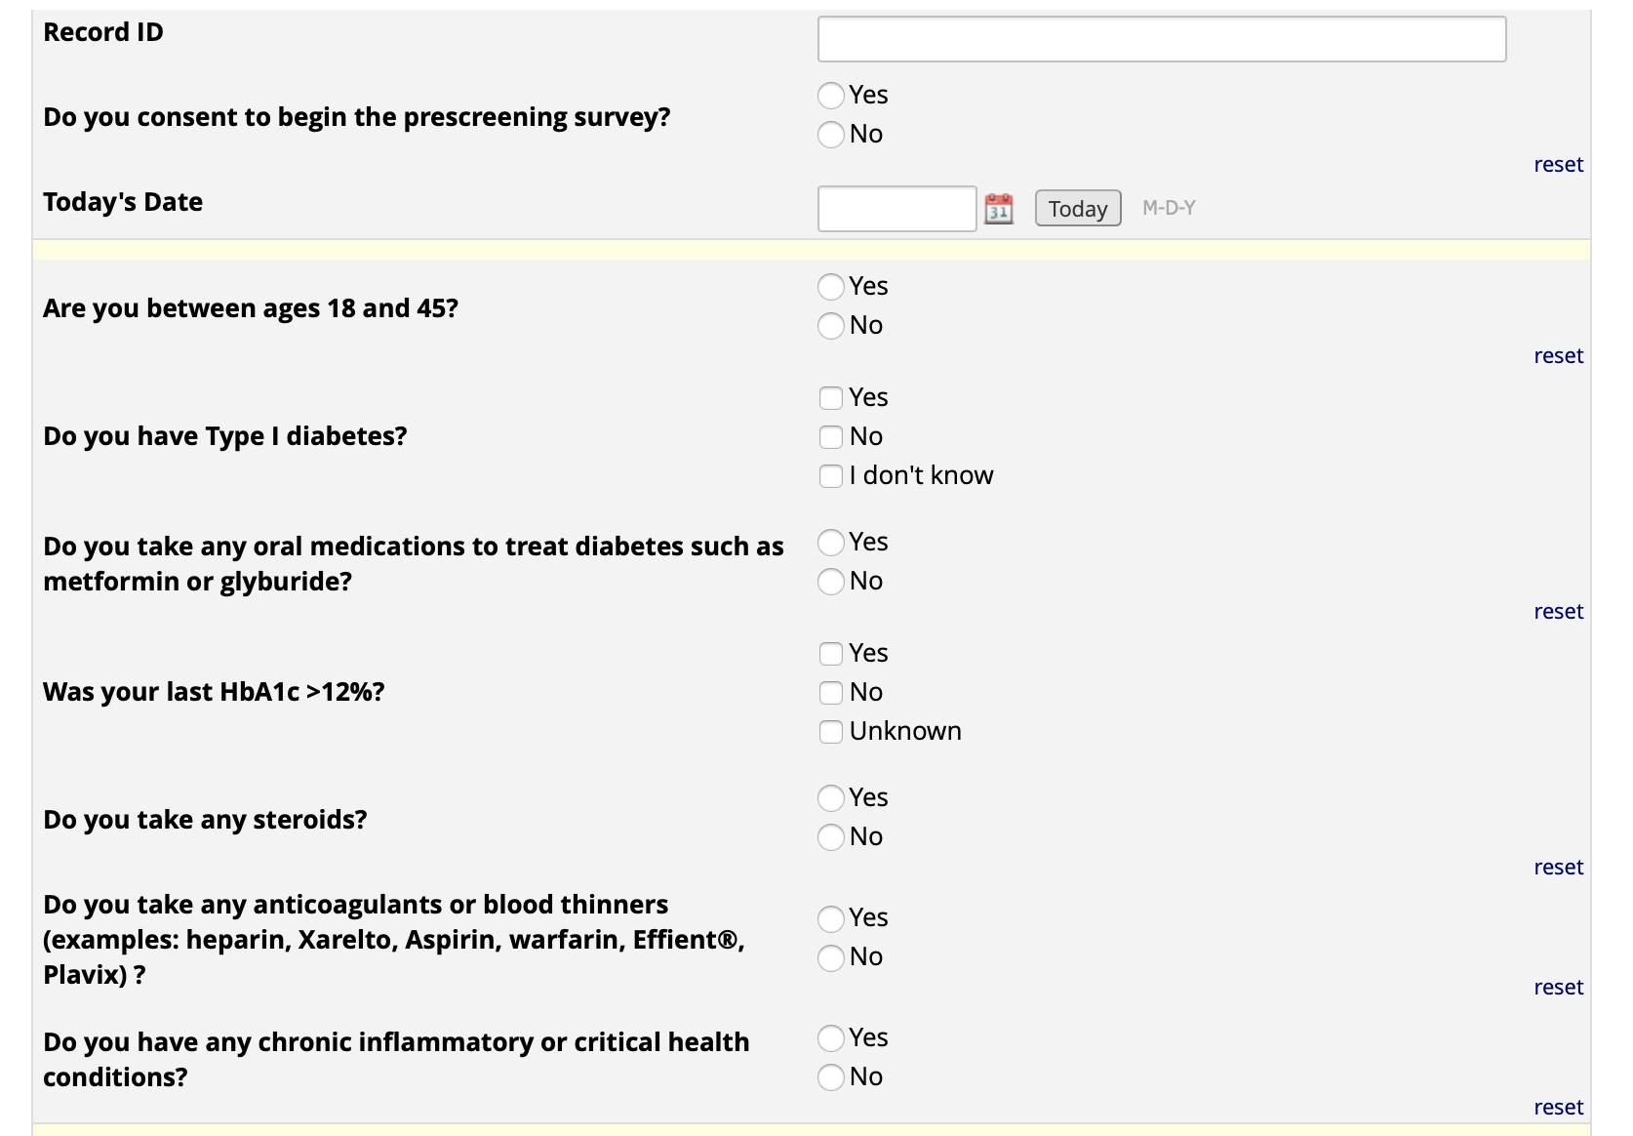
Add your study questions

Slide 11
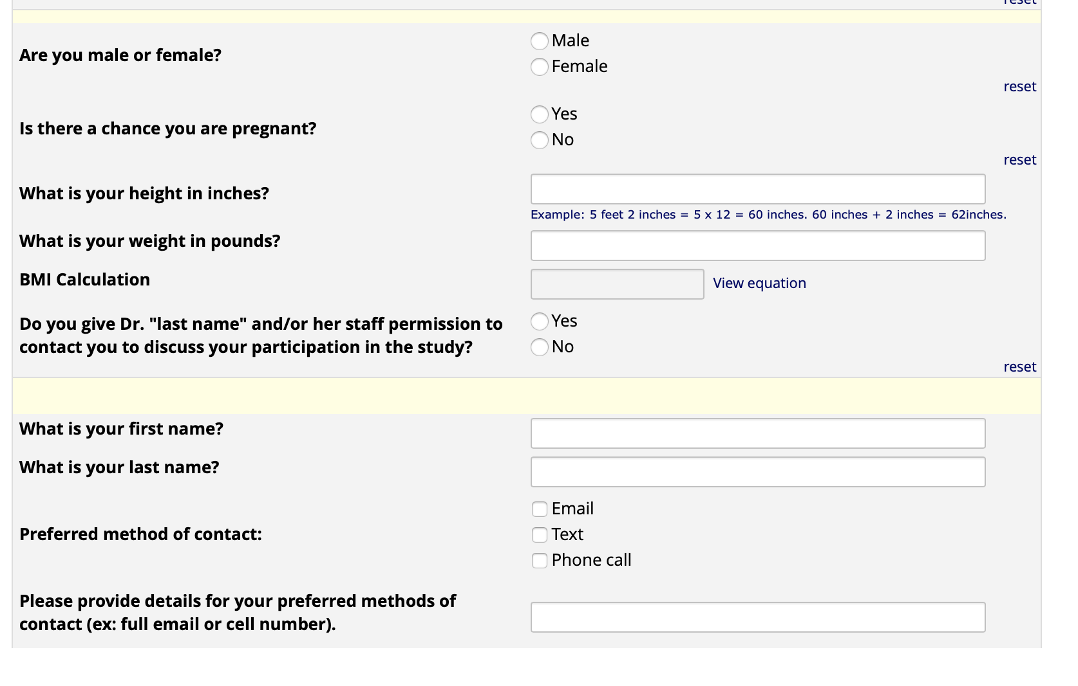

Slide 12
Permission to contact survey questions:
Agreement to be contacted:
If you appear to meet the criteria for the ________ study and you wish for a member of ____________
(principle investigator)’s study team to contact you, include your name and preferred contact information below:
Name: ________________ ______________ _______________
(first) (middle) (last)
Daytime phone: ( ) - Email address: _______________
Permission for investigator to retain information and contact individual with future study opportunities
(include if applicable):
Do you give your permission for ___________(insert investigator or staff) to keep your answers on file and
contact you regarding your willingness to participate in future research studies about _______________
(insert name of disease, condition, or topic area)?
o Yes, ______ may keep my answers and contact information and contact me with future study opportunities. o No. I would like my answers and contact information destroyed when the ____ research study is over.

Slide 13
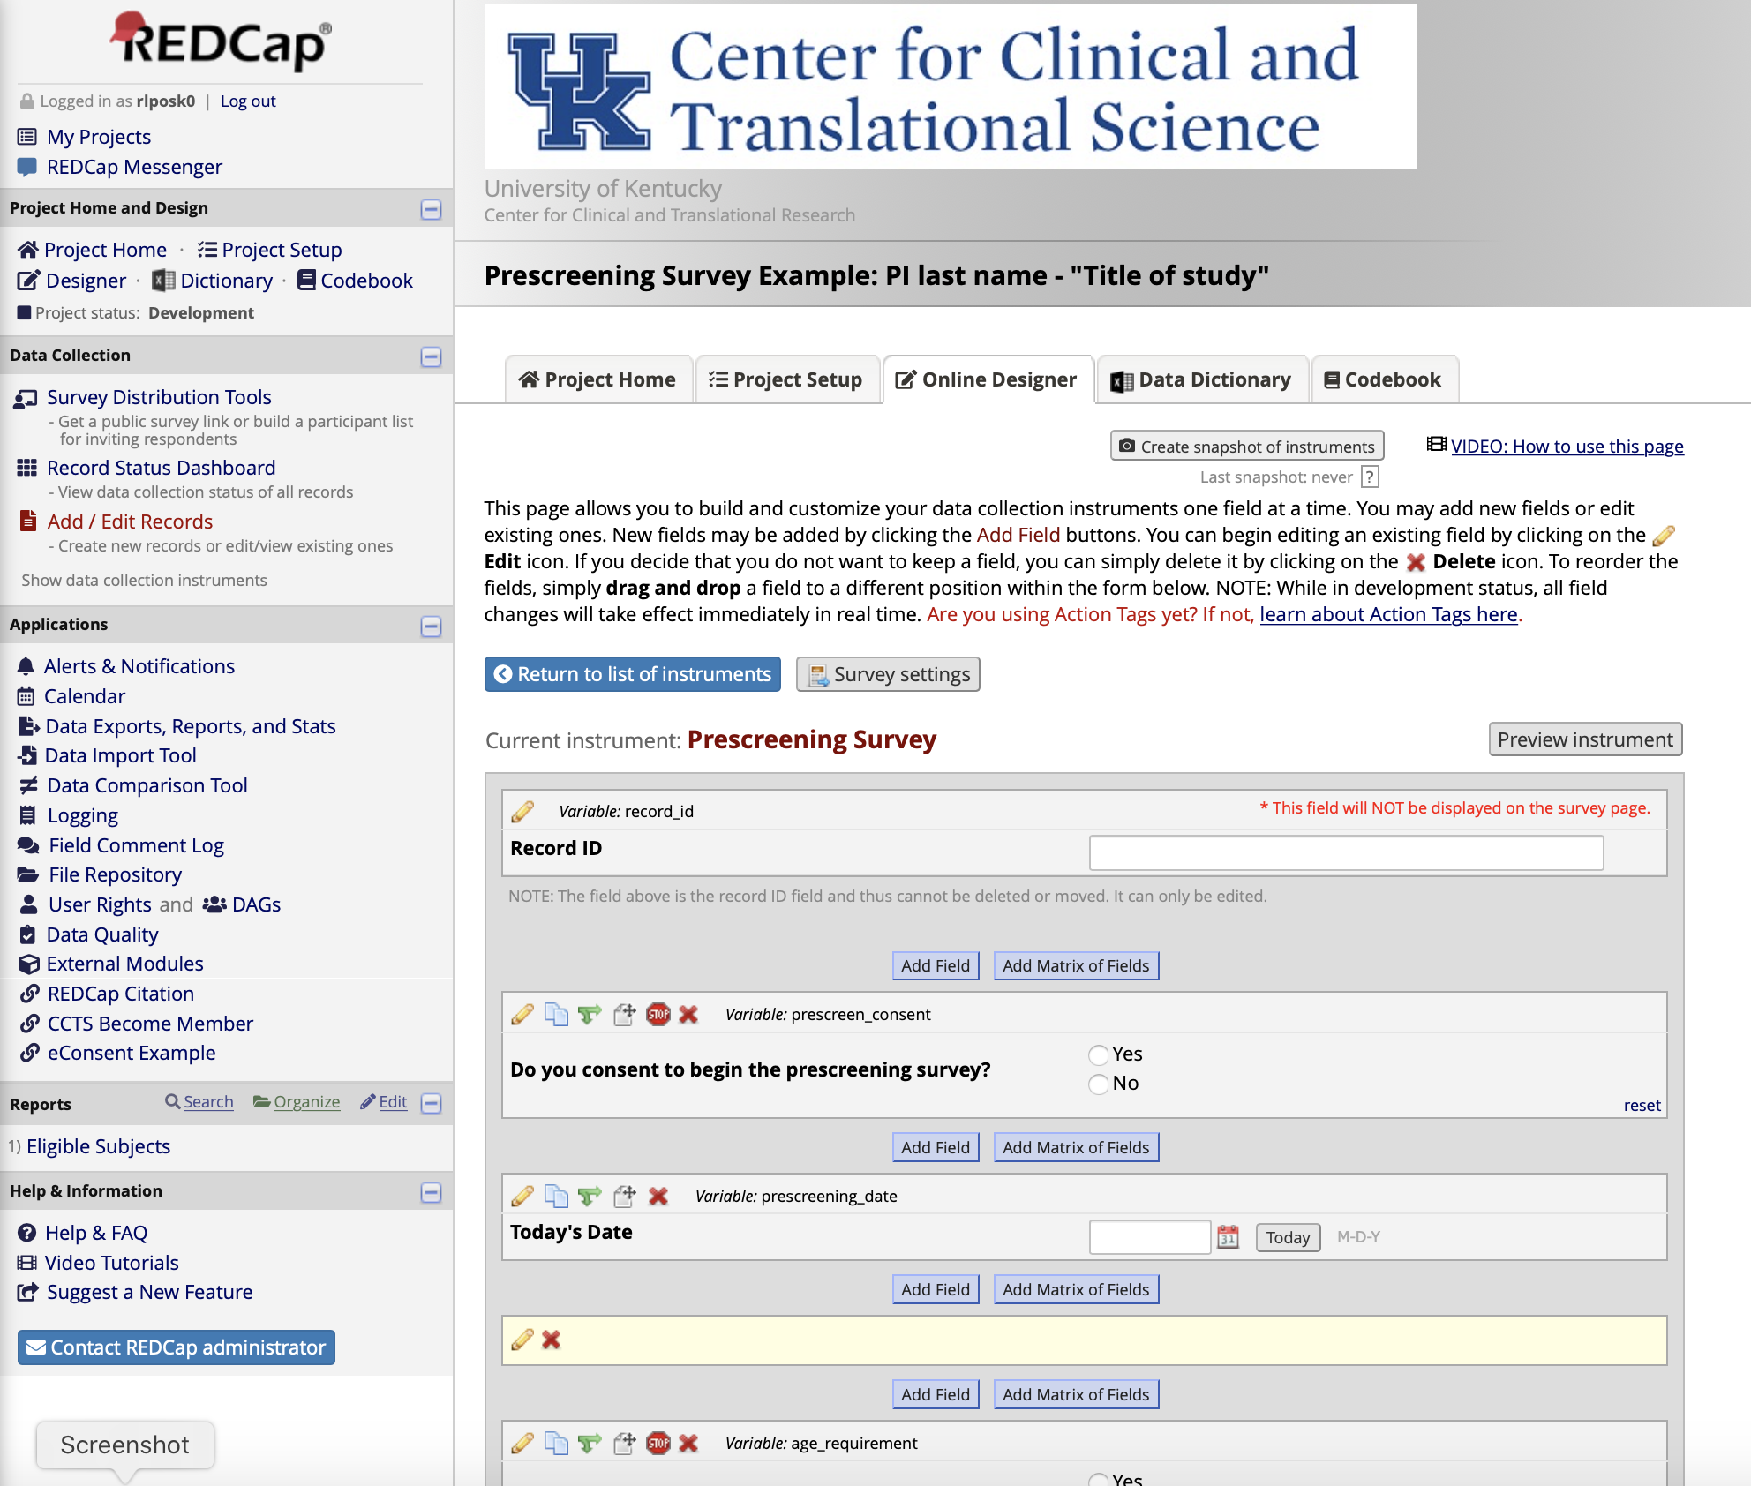
REDCap Example prescreening form:
Production side
Contact: Brent.Seeders@uky.edu for more
information or see REDCap tutorials
When people click a field that states
branching logic more fields open for participants to complete, before selecting
next question.

Slide 14
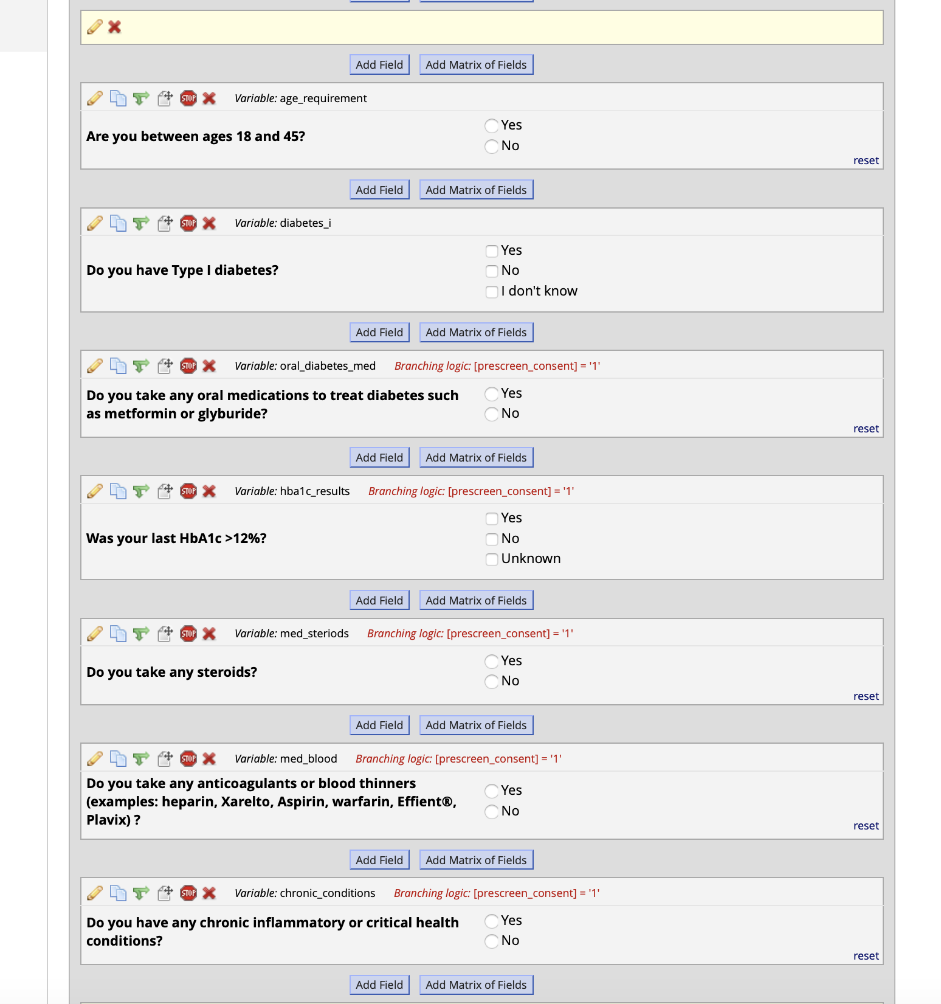

Slide 15
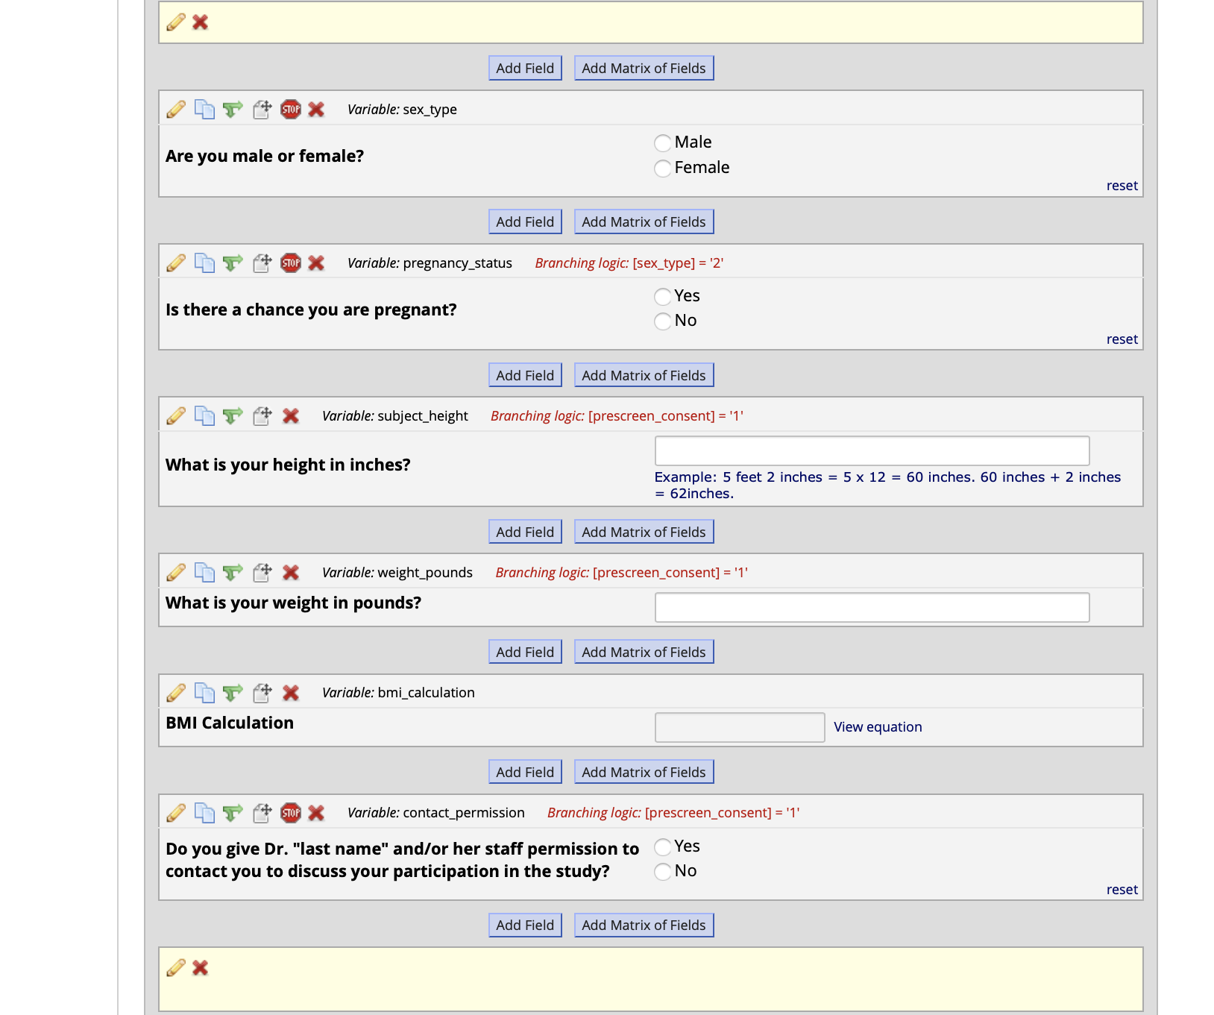

Slide 16
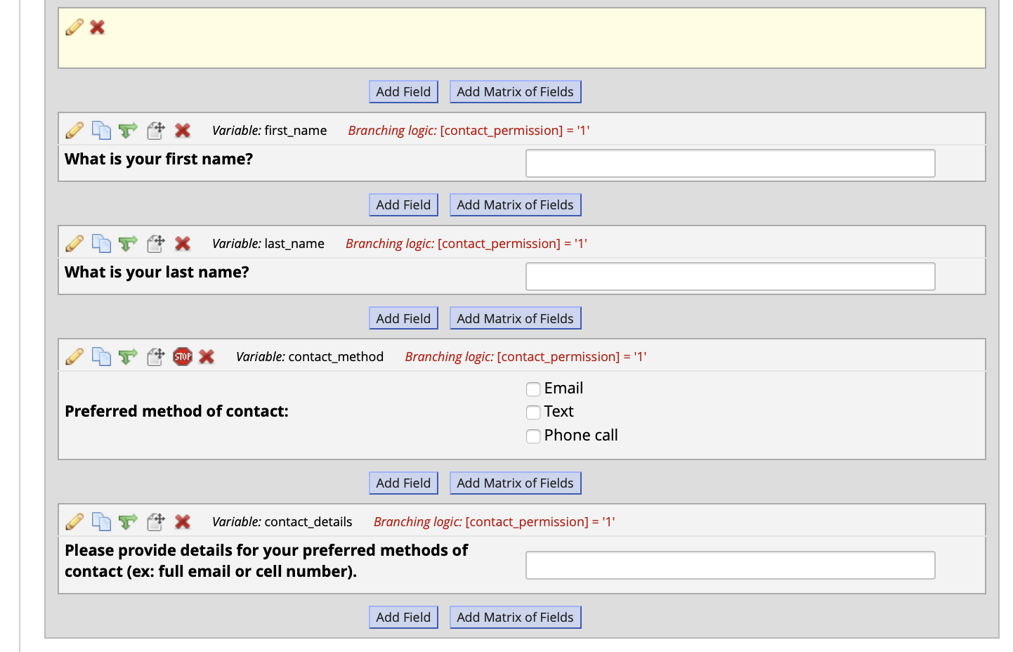

Slide 17
For additional CCTS Services and Information,
please contact CCTSNavigators@uky.edu
Thank you!

